Slide 1

Learning Parameterized Policies
Notes:
1

Slide 2
Objectives
Understand Parameterized Policies
Understand Softmax policy parameterization
Understand the Advantages of Policy Parameterization
Learning Parameterized Policies
2
Notes:
2

Slide 3
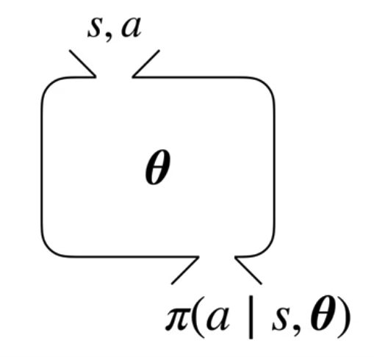
Parameterizing Policies Directly
Using the Greek letter Theta for the policies parameter vector.
Parameterized policy: given the input state and action, the parameterized policy function will output the probability of taking that action in that state.
Learning Parameterized Policies
3
Notes:
3

Slide 4
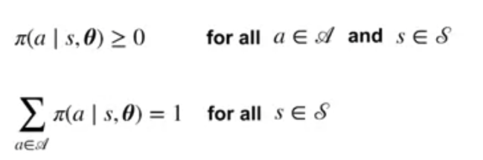
Parameterizing Policies Directly
Constraints on the Policy Parameterization
The parameterized function has to generate a valid policy.
The probabilities selecting an action, must be greater than or equal to zero.
For each state, the sum of the probabilities over all actions must be one.
Learning Parameterized Policies
4
Notes:
4

Slide 5
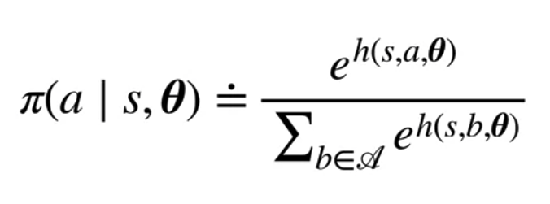
Softmax Policy Parameterization
Example of softmax policies
The function h is called the action preference.
Computing the probability of selecting an action with the softmax: we take the action preference, exponentiate it, and then divide by the sum over all the actions for the same thing
Learning Parameterized Policies
5
Notes:
5

Slide 6
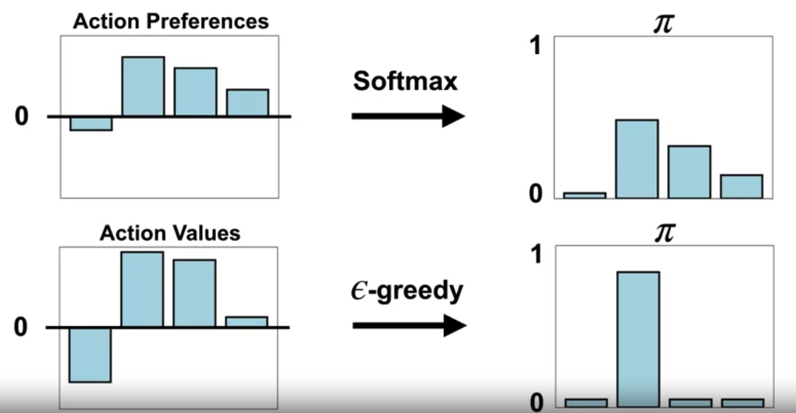
Softmax Policy Parameterization
Action preferences are not action values
Learning Parameterized Policies
6
Notes:
6

Slide 7
Advantages of Policy Parameterization
Compact Representation:
Parameterized policies allow for compact representations of complex policies.
Generalization:
Parameterized policies facilitate generalization across similar states.
Continuous Action Spaces:
Parameterized policies can easily handle continuous action spaces.
Learning Parameterized Policies
7
Notes:
7

Slide 8
Advantages of Policy Parameterization
Flexibility:
Parameterized policies offer flexibility in representing a wide range of policies.
Learning Complex Policies:
Parameterized policies are well-suited for learning complex policies in high-dimensional state spaces.
End-to-End Learning:
Parameterized policies support end-to-end learning, where the policy function is directly optimized to maximize cumulative rewards.
Learning Parameterized Policies
8
Notes:
8

Slide 9
Advantages of Policy Parameterization
Policy parameterization offers a powerful framework:
Representing and Learning policies in reinforcement learning,
Enabling agents to effectively navigate complex environments
Achieve high-performance outcomes.
Learning Parameterized Policies
9
Notes:
9

Slide 10
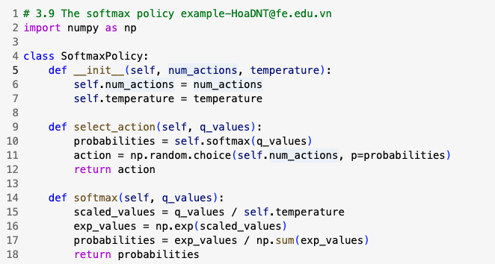
The Softmax Policy example
Using a softmax policy to select actions in a simple grid world environment.
Learning Parameterized Policies
10
Notes:
10

Slide 11
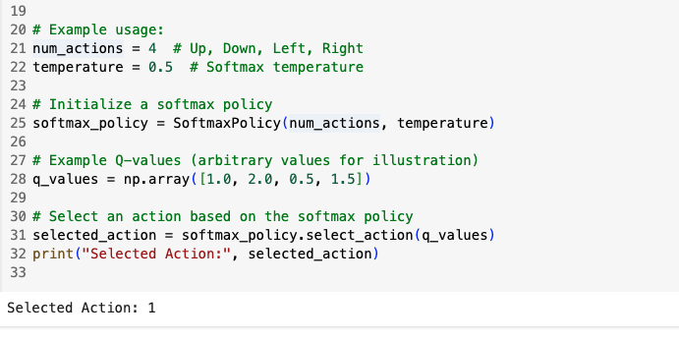
The Softmax Policy example
Learning Parameterized Policies
11
Notes:
11

Slide 12
Summary
Understand Parameterized Policies
Understand Softmax policy parameterization
Understand the Advantages of Policy Parameterization
Learning Parameterized Policies
12

Slide 13
Q & A
Learning Parameterized Policies
13

